Slide 1

Exploring the Bitcoin Cryptocurrency Market
Notes:
1. Table of contents
2. Introduction
3. Our company
4. Our team
5. Problem
6. Them vs. us
7. Solution
8. SWOT analysis
9. Product overview
10. Our plans
11. Product demo
12. Traction
13. Case study
14. Reviews
15. Awards
16. Market size
17. Target
18. Competitors
19. Business model
20. Timing
21. Predicted growth
22. Investment

Slide 2




Team Members
Karthik Vinnakota
Sai Krishna Gudipati
Team Leader
Data Scientist
Jaya Krishna Chinthaginjala
Ayyappa Tata
Data modeler
Data Visualization

Slide 3

Introduction
Bitcoin has emerged as a decentralized digital currency, capturing significant attention and popularity. This presentation explores the cryptocurrency market using data science techniques. We aim to uncover trends, dissect market movements, and project potential future developments in this dynamic and evolving space.

Slide 4
Challenges in Exploring the Bitcoin Cryptocurrency Market
Identifying and addressing the obstacles in Bitcoin cryptocurrency market analysis
Volatility
Navigating the unpredictable price fluctuations of Bitcoin presents inherent challenges, complicating the accurate prediction of market trends.
Data Quality
Challenges may arise in ensuring the trustworthiness and precision of data sources, affecting the overall reliability of the information at hand.
Lack of Regulation
Market uncertainty is heightened by the lack of well-defined regulations, contributing to an environment where clear guidelines are absent.

Slide 5
Solutions for Analyzing the Bitcoin Cryptocurrency Market
Effective strategies to overcome challenges in Bitcoin cryptocurrency market analysis.
Advanced Data Analysis Techniques
Apply statistical models and machine learning algorithms to scrutinize trends within the market.
Diversify Data Sources
Enhance precision and mitigate bias by aggregating data from diverse and trustworthy sources
Monitor Regulatory Developments
Continuously monitor regulatory alterations and modify analyses in response to ensure relevance and accuracy.

Slide 6
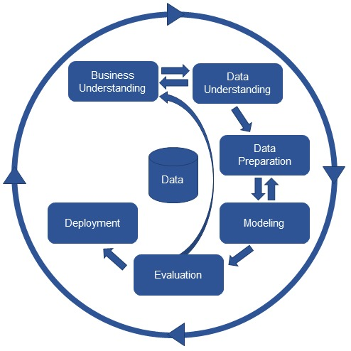
CRISP-DM Methodology

Slide 7
Business Understanding in Bitcoin Cryptocurrency Market Analysis
Gaining Insights into the market dynamics and trends.
Market Size and Growth
Competitive
Landscape
Customer Segmentation
Market Opportunities
Evaluate the current scale of the market and anticipate its future trajectory of growth.
Determine significant competitors and analyze the distribution of their market presence.
Understand the spectrum of Bitcoin investors and their preferences
Identify opportunities for expansion and potential investment areas in the market.

Slide 8
Data Requirements for Bitcoin Cryptocurrency Market Analysis
Exploring the available data sources and their characteristics
Historical Price Data
Trading Volume
Social Media Sentiment
Regulatory News
Analyze the past price movements and Patterns.
Access the liquidity and Market activity.
Monitor public sentiment and it’s impact on the market.
Track regulatory announcements and their influence on the market.

Slide 9
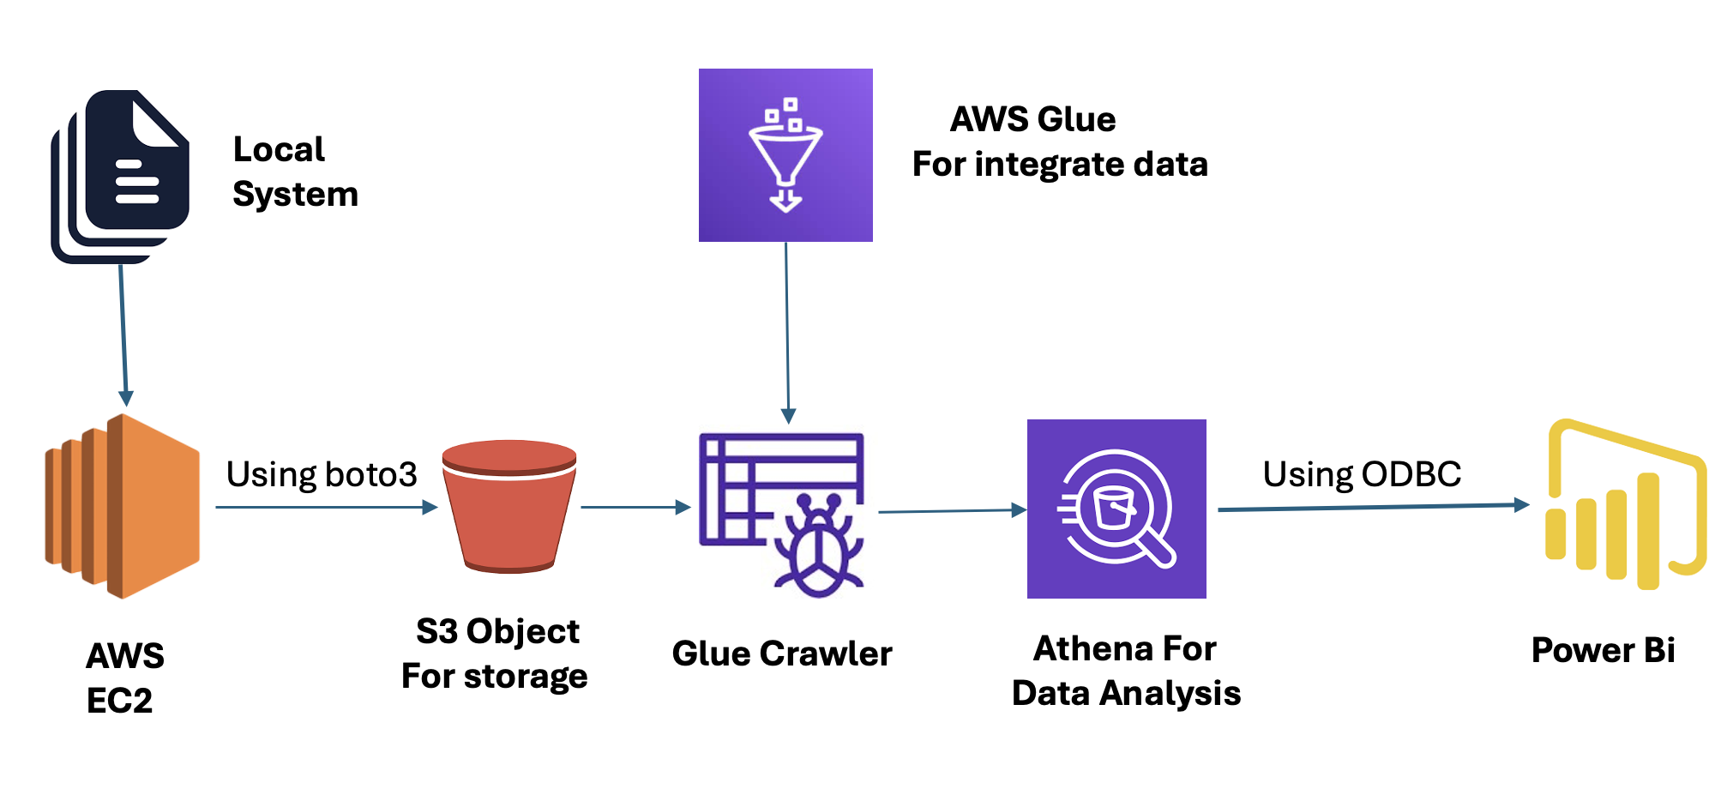
Data Pipeline

Slide 10

Uploading Data to AWS EC2

Slide 11
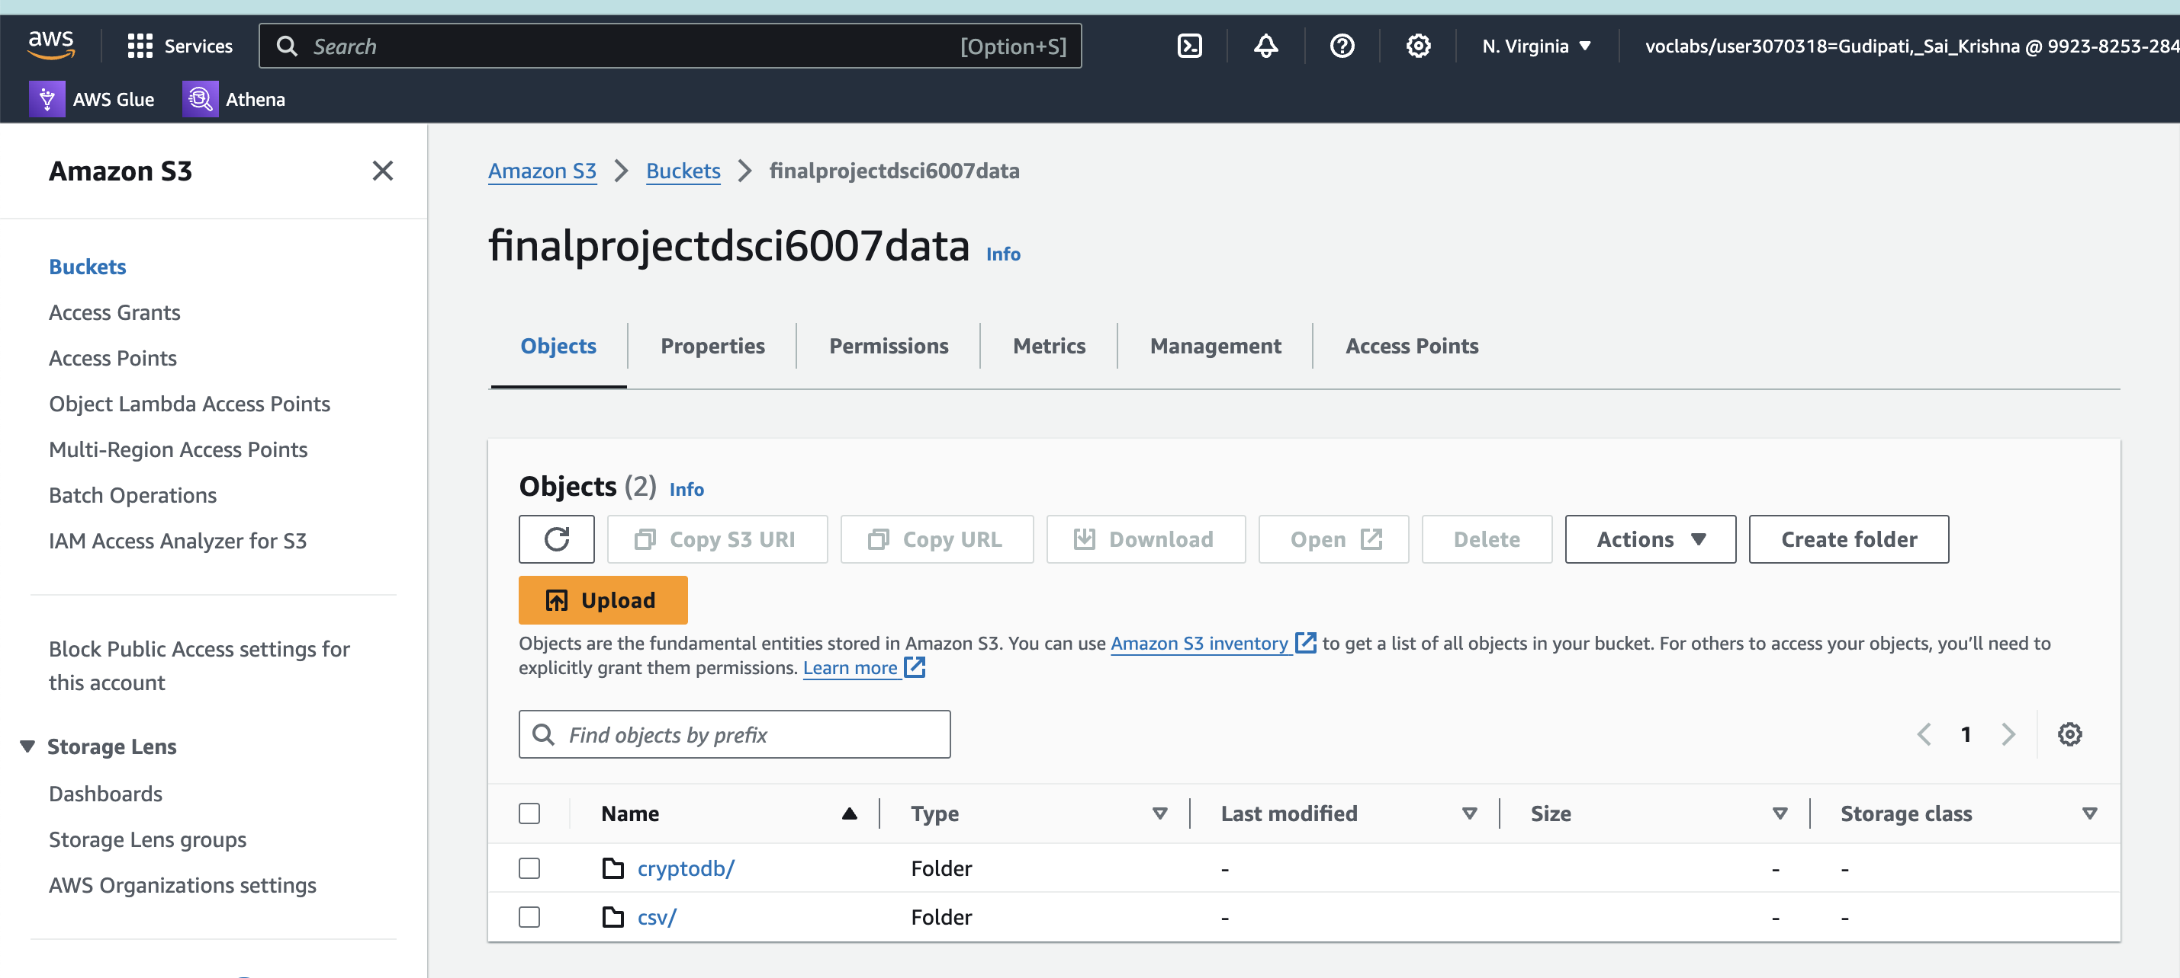
Connecting to AWS S3

Slide 12
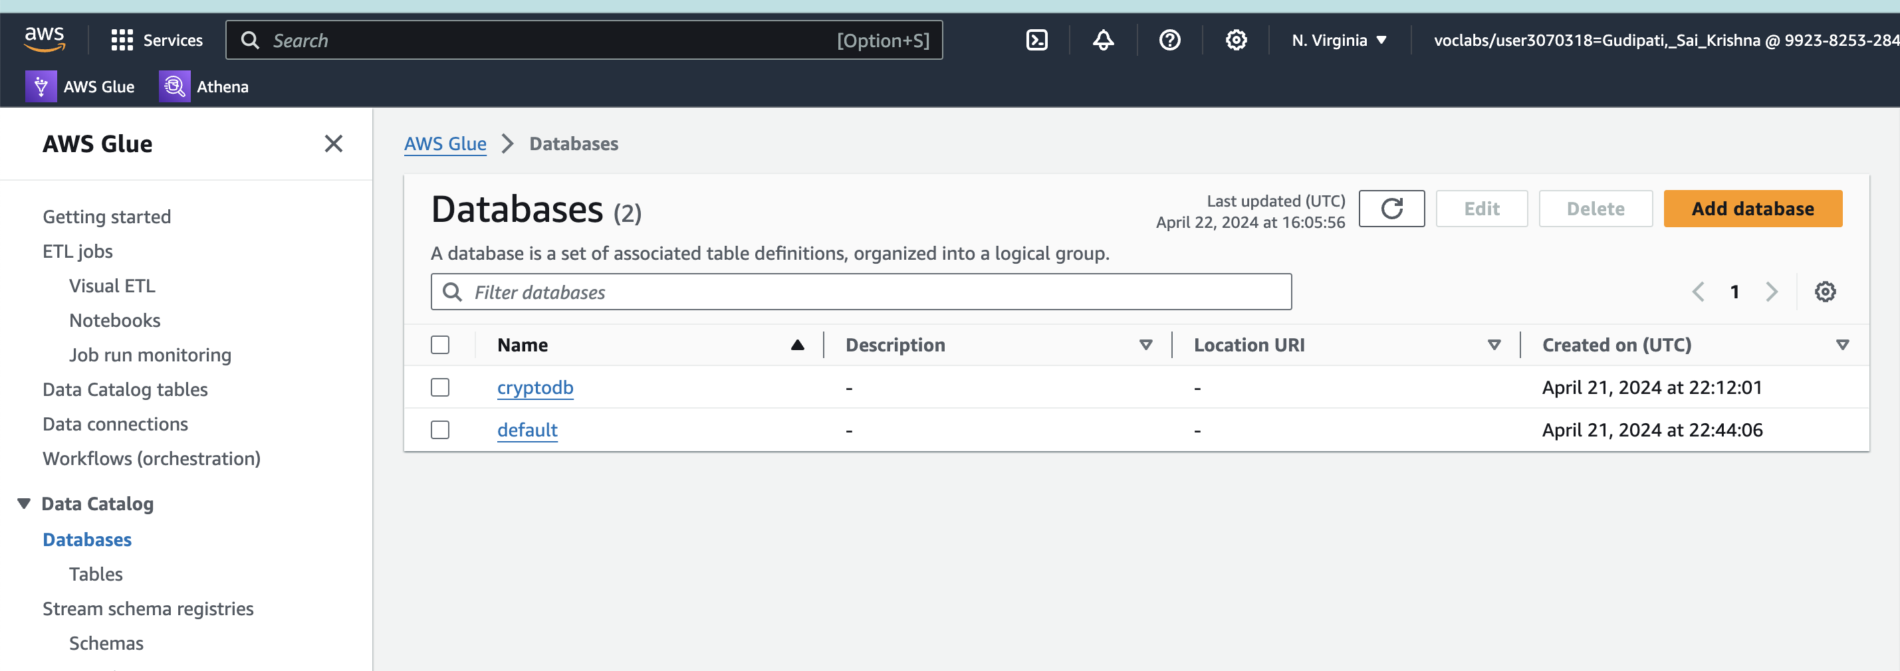
Database Created in AWS Glue

Slide 13
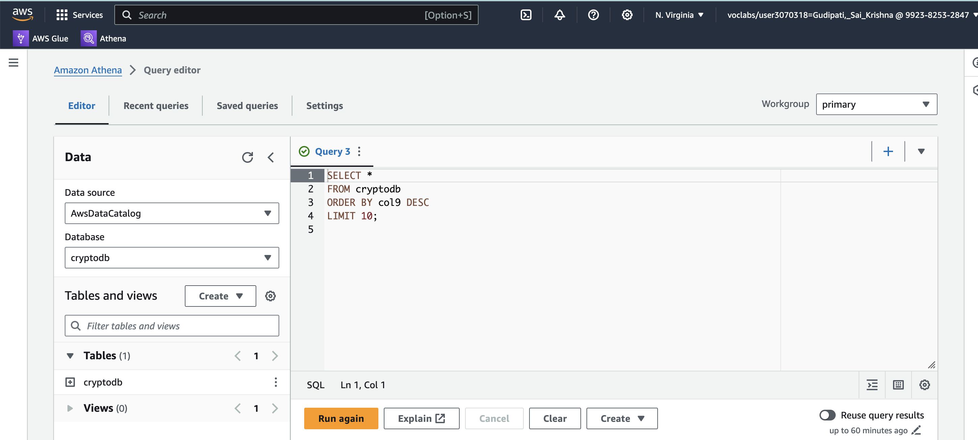
Queries Run Using AWS Athena

Slide 14
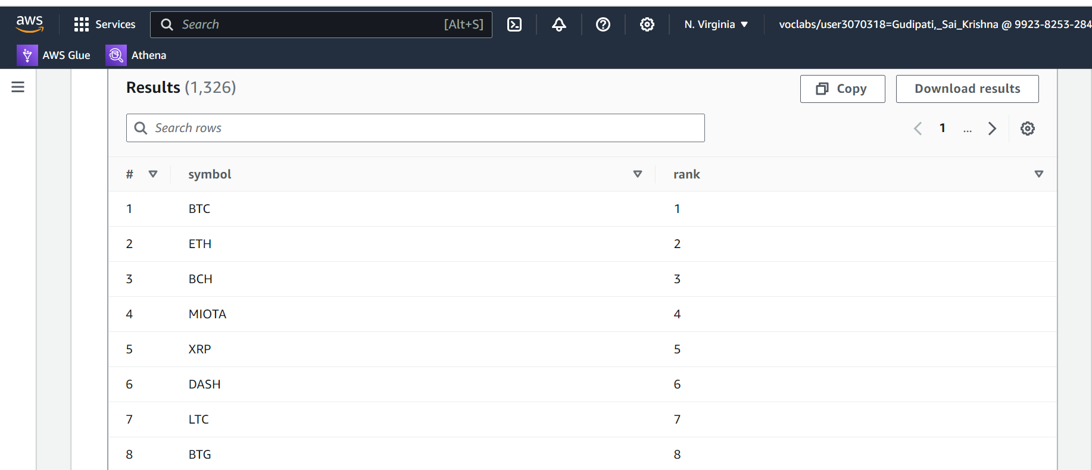
Results of Cryptocurrency Ranking Analysis
SELECT symbol, rank
FROM cryptodb
ORDER BY rank;

Slide 15
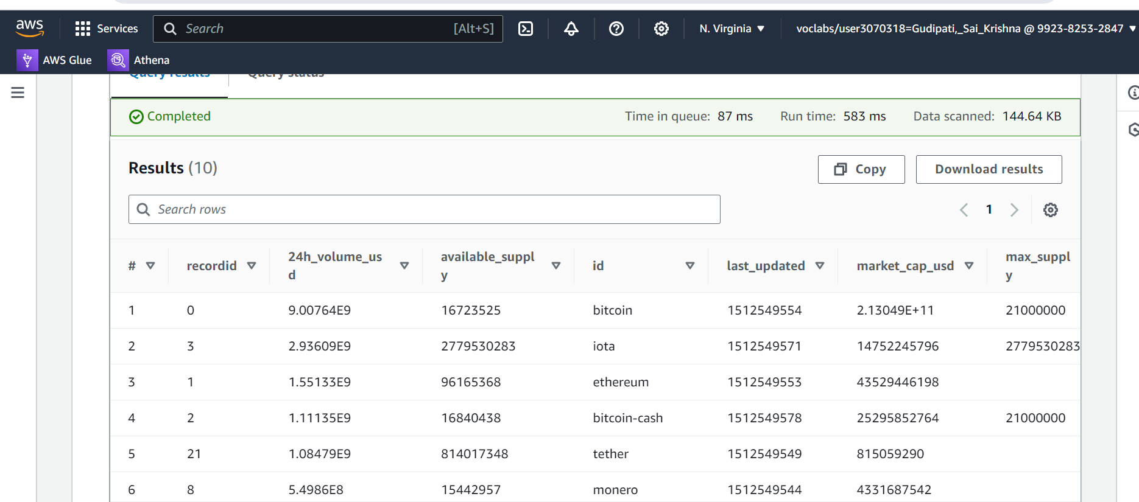
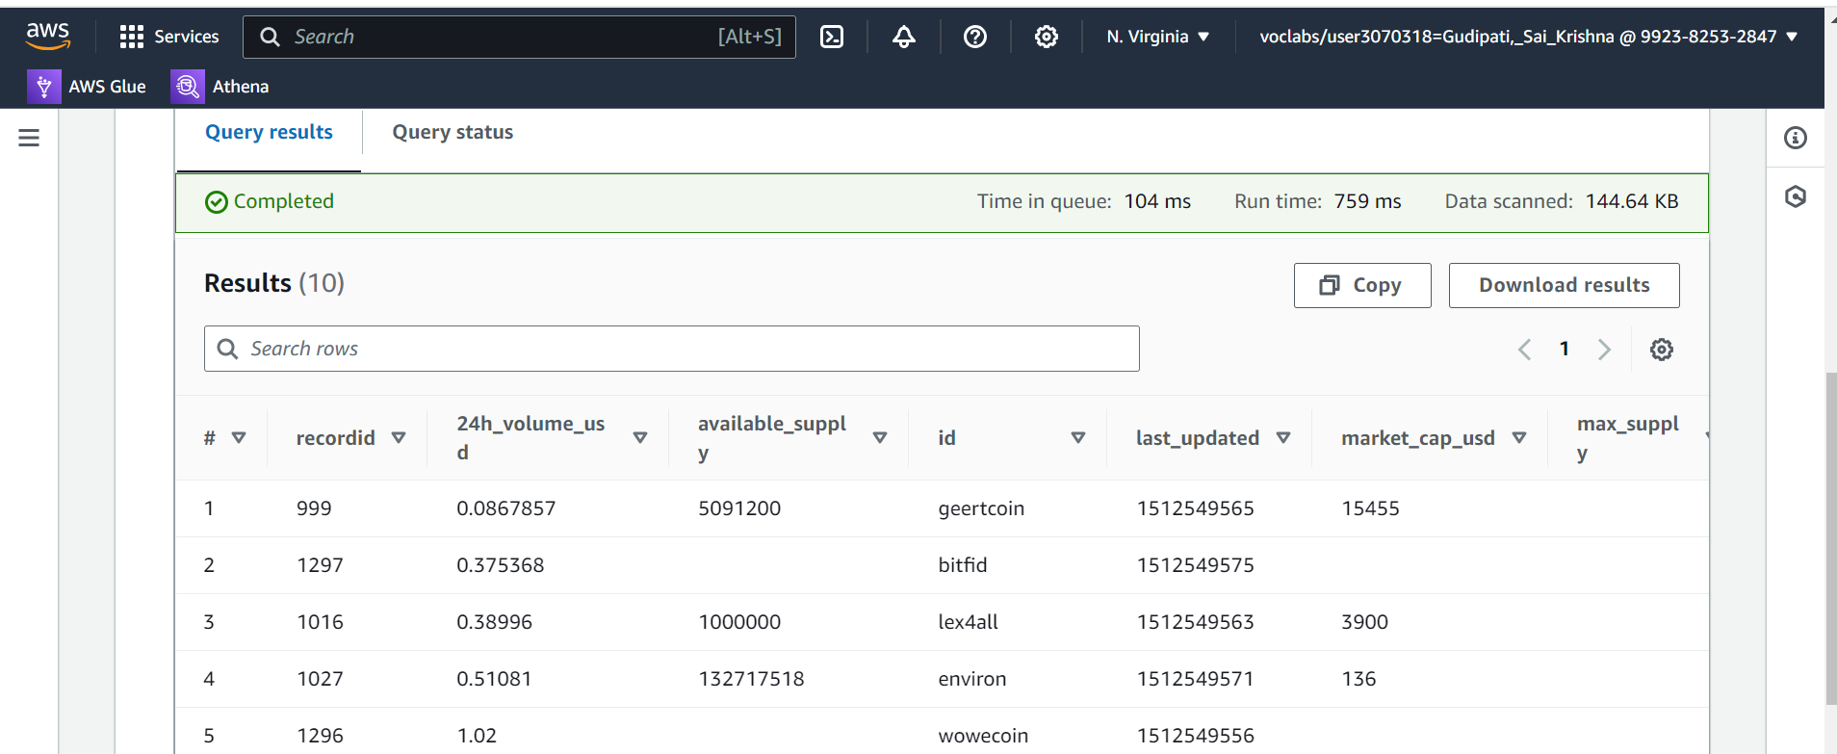
Cryptocurrency With Highest & Lowest Trading Volume
SELECT * FROM cryptodb
ORDER BY CAST ("24h_volume_usd" AS DECIMAL(38, 2)) DESC
LIMIT 10;
SELECT * FROM cryptodb
WHERE "24h_volume_usd" IS NOT NULL AND "24h_volume_usd" != 0.0
ORDER BY CAST("24h_volume_usd" AS DECIMAL(38, 2)) ASC
LIMIT 10;

Slide 16
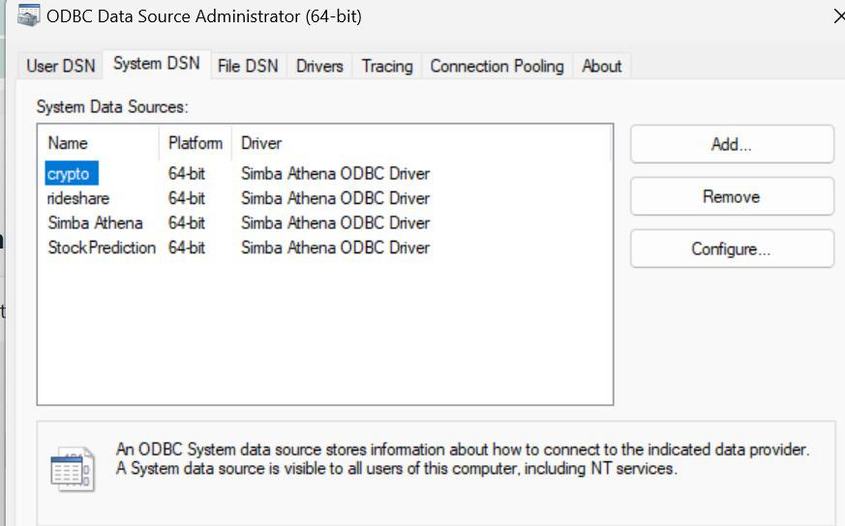
Connecting AWS Athena to Power BI Using ODBC
Connecting AWS Athena to Power BI via ODBC involves setting up Athena permissions, installing the Athena ODBC driver, configuring an ODBC data source, and connecting Power BI using the provided connection details.

Slide 17
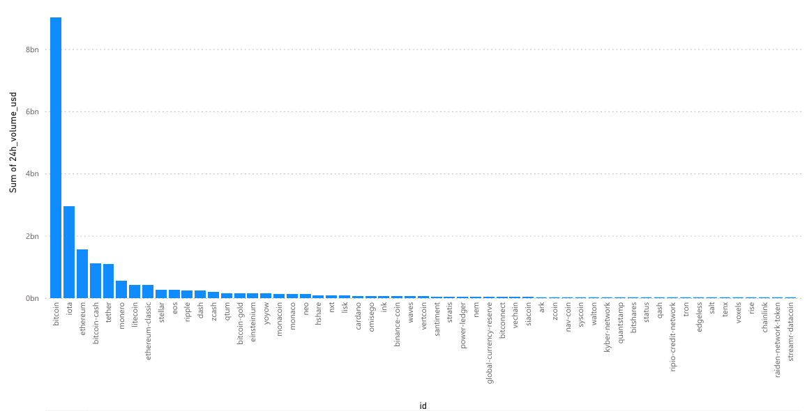
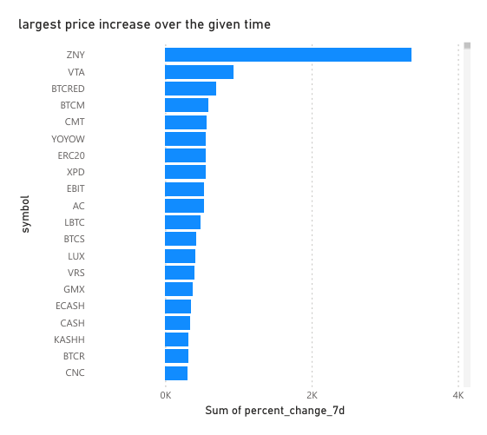
Data Visualization using Power BI

Slide 18
References:
Narayanan, A., Bonneau, J., Felten, E., Miller, A., & Goldfeder, S. (2016). Bitcoin and Cryptocurrency Technologies: A Comprehensive Introduction.
Grinberg, R. (2012). Bitcoin: An Innovative Alternative Digital Currency.
Yermack, D. (2015). Is Bitcoin a Real Currency? An Economic Appraisal.
Tseng, J. J., Liang, C., & Fei, L. (2018). Forecasting Bitcoin Price with Graph Chainlets.
Nakamoto, S. (2008). Bitcoin: A Peer-to-Peer Electronic Cash System. [Whitepaper]
Antonopoulos, A. M. (2014). Mastering Bitcoin: Unlocking Digital Cryptocurrencies.

Slide 19
Thank you!

